Slide 1

COMP10001 workshop
Semester 2, 2019

Slide 2
Our Workshops
We know that there will be consultation time between you and the lecturer
You are given practice exams
You can ask question on the subject discussion forum
Lecturers will NOT tell you about the exam contents
Past exams can be ‘recursive’ (No pun intended). So it is crucial to hear from past peers
Discussion is limited to subject content but not about exam structures

Slide 3
Our Presenters
Jansen
Betty
Andrew
Data Structures
Recursion
File Handling
Andy
Kaif
HTML and Web Structure
Exam Questions

Slide 4
Data Structures

Slide 5
List (Array)
[ 1, 2, 3, 4, 5]
[’unimelb’,’monash’, ‘rmit’]
mutable
Ordered

Slide 6
List (Array)
e.g. arr = [1,2,3]
To add: arr.append(4)
To remove: arr.remove(2) OR .pop()
To take a substring: arr[1:3]
Take an element w.r.t the end of a list: arr[-1]
To find the value in a certain index: arr[1]
To find the index of a certain value: arr.index(1)

Slide 7
List (Array)
e.g. arr = [1,2,3], arr2 = [4,5,6]
Change element in a certain index: arr[1] = “hello”
To get the length: len(arr)
Iterate through a list: for x in arr: …
See if element in a list: if 2 in arr: …
Combine lists: arr + arr2
Sort a list: sort(arr)

Slide 8
Tuples
(1, 2) 🡪 2-tuple
(1, 2, ‘a’) 🡪 3-tuple
Immutable
Ordered

Slide 9
Tuples
e.g. t = (1,2,3)
To get item from tuple: t[1] OR t[-1
To get a part of the tuple t[1:-1]

Slide 10
Dictionaries
{1: ”hi”, 2: “python”, 3: “codeislyfe”}
Mutable
Not ordered

Slide 11
Dictionaries
E.g. b = {1: ”hi”, 2: “python”, 3: “codeislyfe”}
To initialize: b ={}
To add a key and value: b[‘4’] =“added”
To get a value of a key: b[‘4’]
To remove a key: b.pop(1)
Find how many elements: len(b)

Slide 12
Dictionaries
E.g. b = {1: ”hi”, 2: “python”, 3: “codeislyfe”}
Iterate through each key: for x in b: …
Iterate through the values: for y in b.values()
Iterate through keys and values: for (key, val) in b.items()

Slide 13
Sets
{1,2}
Unordered
No repeated elements

Slide 14
Sets
s = {1,2,3,4,5}
Access elements: for x in s: …
Is element in set? x in s
Add element: s.add(6)
Add multiple: s.update([x,y])
Remove element: s.remove(1) OR s.discard(1) OR s.pop()
Length of set: len(s)
Notes:
Remove has error, discard has no error if elem does not exist

Slide 15
Sets
e.g. s1 = {1,2,3}, s2 = {3,4,1}
Union of sets: s1.union(s2)
Intersection: s1.intersect(s2)
Difference: s1.difference(s2)
Notes:
Difference gets rid of shared elements

Slide 16
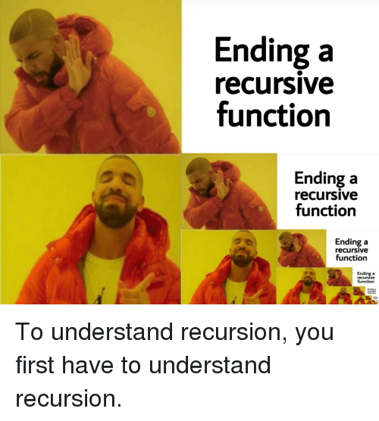
Recursion

Slide 17
Introduction to Recursion
“When no one wants to call you, you call yourself.”
A recursive function is one that calls itself one or more times in its body.
A recursive function breaks a big problem into smaller parts, and calls itself for each small part.

Slide 18
Recursive Function
Base Case
A condition / guard.
Function terminates once Base Case is reached.
Recursive Case
Where the function calls itself.
Process of breaking down big problem. into smaller parts
Must converge to Base Case.

Slide 19
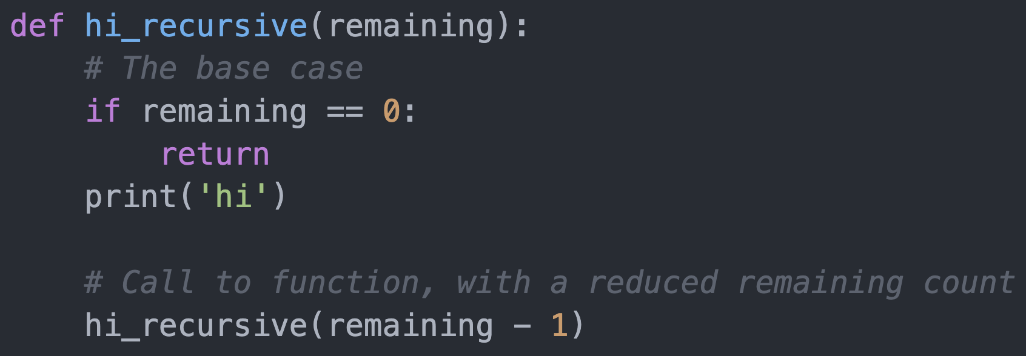
Example
Base Case condition
Base Case action
Recursive Case action
Recursive Case input

Slide 20
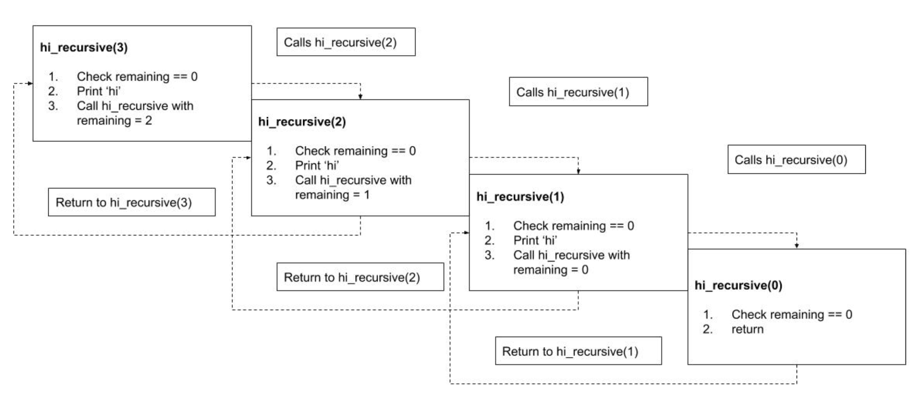

Slide 21
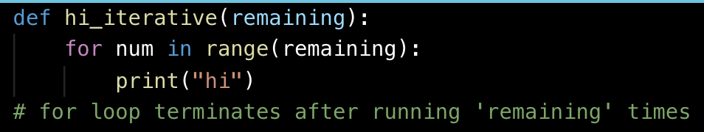
Recursion vs Iteration
Recursion: break down a large task to smaller tasks
Iteration: repeat a task over and over again

Slide 22
Why Recursion?
Advantages of Recursion
Elegance: clean and neat code.
Divide-and-conquer rather than brute force.
Advantages of Iteration
Logic is easier to follow for beginners.
Efficiency (most cases): cheaper to call than recursion (cost less time and memory).

Slide 23
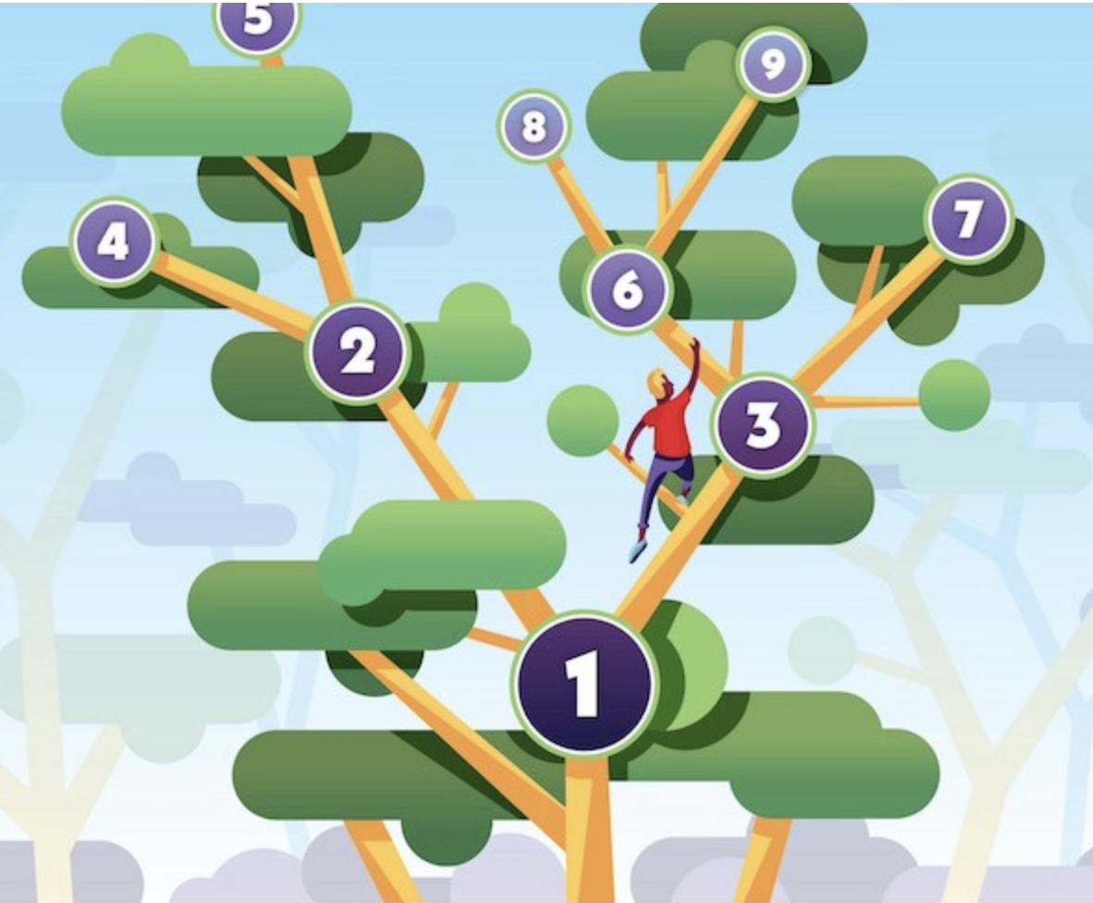
When to Use?
Other than the classic factorial-finding / fibonacci sequence calculating problems…
Traversing through nodes and leaves of a tree (a data structure!) is usually easily done with recursion.
E.g. Recursively visit left branch of the tree until result node (base case) is reached.

Slide 24
More Examples
Detailed example on…
HOW SANTA CLAUS CAN DELIVER PRESENTS RECURSIVELY!
https://realpython.com/python-thinking-recursively/

Slide 25
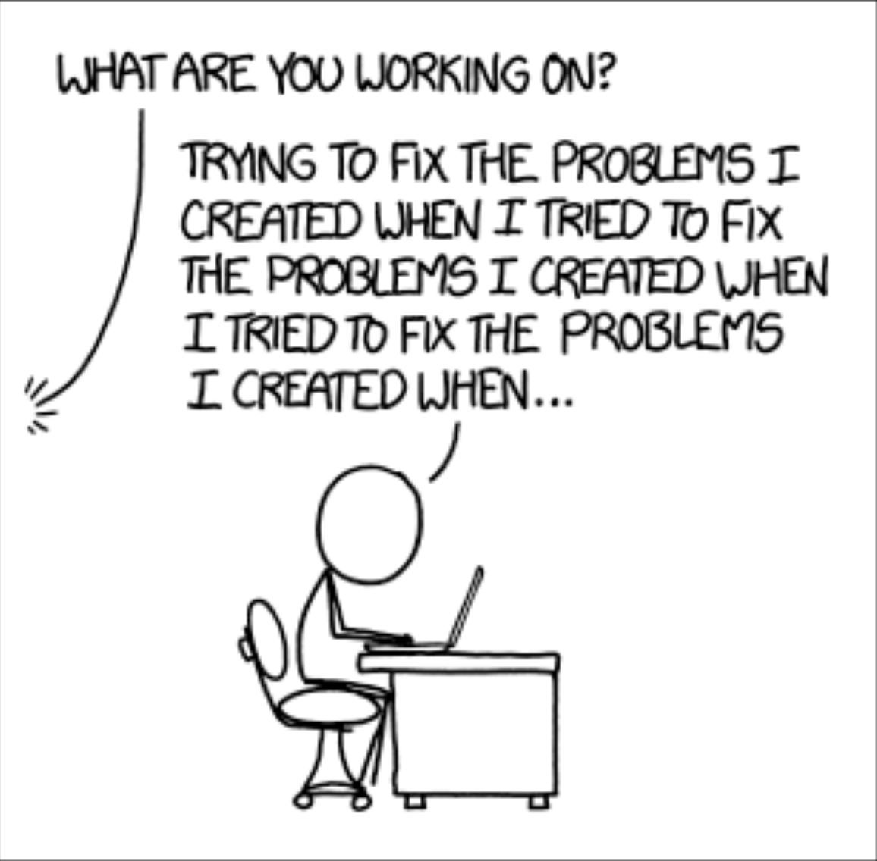
Introduction to HTML

Slide 26
File Handling
How can we interact with files
Read
Write
Can working with CSV files be easy?
Andrew

Slide 27
The File Object
Very Pythonic
Can read all the text to you
Or read text to you line by line
Remembers which line you are up to
How do we get it?
file_object= open(“filename.___”)

Slide 28
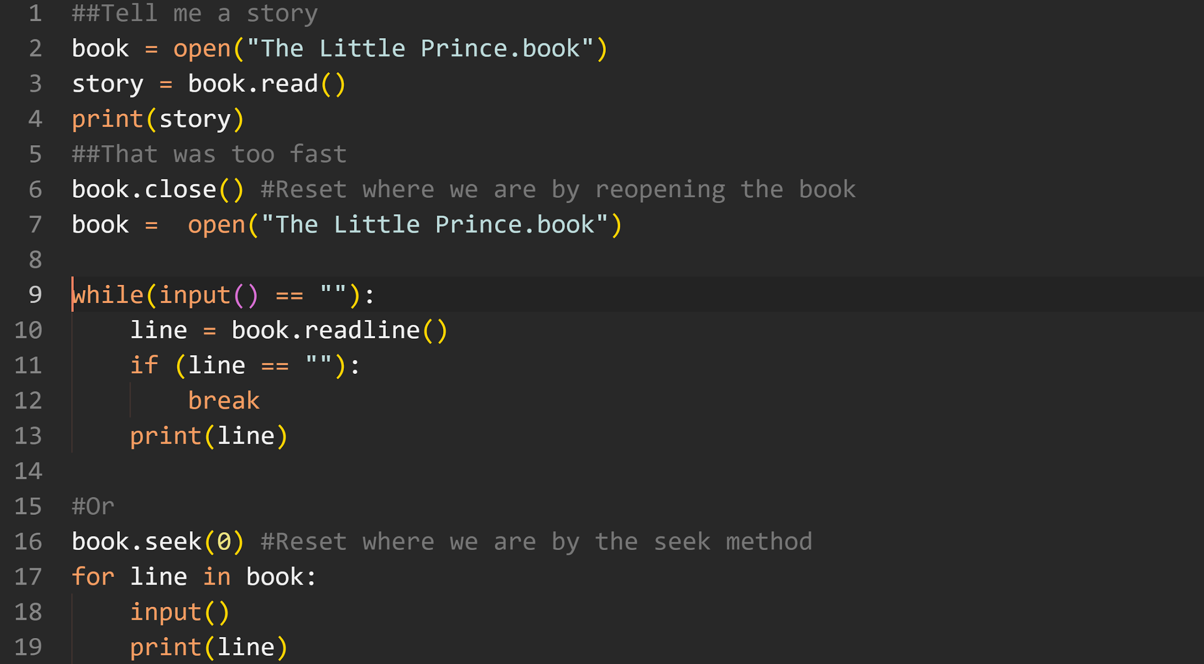

Slide 29
What if we want to write
Let’s rewrite The Little Prince
Book = open(“The Little Prince.book”, “w”)
Or let’s just write the next chapter
Book = open(“The Little Prince.book”, “a”)

Slide 30
I want to both write and read
Book = open(“The Little Prince.book”, “w+”)
Also creates files for us
MyBook = open(“Arrowsmith.book”, “w+”)
What’s up with modes?
Very not python (not nice)
Came from C (the grandfather language, lives in Foundations of Algorithms)
FILE *book = fopen(“filename”, “w+”)
“r” / open(), “w”, “a”, “w+”

Slide 31
Working with data - Comma Separated Files
A real life example

Slide 32
The csv module
Someone made our lives easier
You can access these functions by
import csv
All functions inside start with csv.
Upgrades your file object
data_list = csv.reader(file_object)
data_dict = csv.DictReader(file_object)

Slide 33
How have they been represented
List
Just a collection of values
Each line is distinct
We care about separating values
data_list[line][0:10]
Dictionary
We have a table
Each line is distinct
We care about separating values by columns
data_dict[line][‘column’]

Slide 34
The Internet/HTML
What is the Internet/WWW?
IP addresses
URL
Intro to HTML

Slide 35
What is the Internet?
A massive global system of networks where any computer can communicate with any other computers.
It is a way for computers to share information, such as transferring files or sending emails.
The World Wide Web is the most common use of the Internet.

Slide 36
What is the WWW?
The World Wide Web (WWW) is a platform where resources can be shared and accessed via the Internet.
The Internet is a network infrastructure, the WWW is a service that is built upon the Internet.

Slide 37
IP Addresses
Each computer has a unique IP address
205. 78. 280. 20
Made up of four “8-bit” numbers, each number between 0 and 255, separated by dots.

Slide 38
URLs
http://www.example.com:80/index.html
scheme://hostname:port/path

Slide 39
Summary
The Internet is the network infrastructure that connects computers together.
The WWW is the most commonly used service on the Internet.
Each computer/server has its unique IP address and hostname.
Resources on the Internet can be located with URLs, which is made up of a scheme, hostname, port, and path.
https://www.youtube.com/watch?v=J8hzJxb0rpc

Slide 40
Introduction to HTML
Hypertext Markup Language (HTML) is used to format documents on the web that you see in your browser.
HTML documents are made up of tags. Tags come in pairs. A starting tag and an ending tag:
<tag> …. </tag>
Starting tag
Ending tag (starts with backslash)

Slide 41
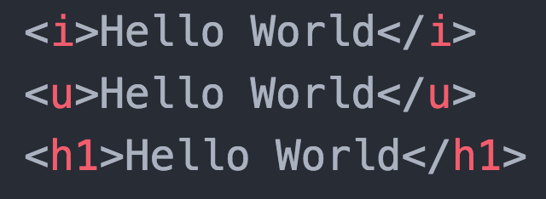
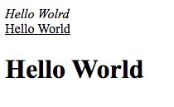
Introduction to HTML

Slide 42
Declare file type
<!DOCTYPE HTML>
<html>
<head>
...
</head>
<body>
...
</body>
</html>
Start of HTML file
Start of Header section
(Contains metadata and title)
End of Header section
Start of Body section
( Contains website content)
End of Body section
End of HTML file

Slide 43
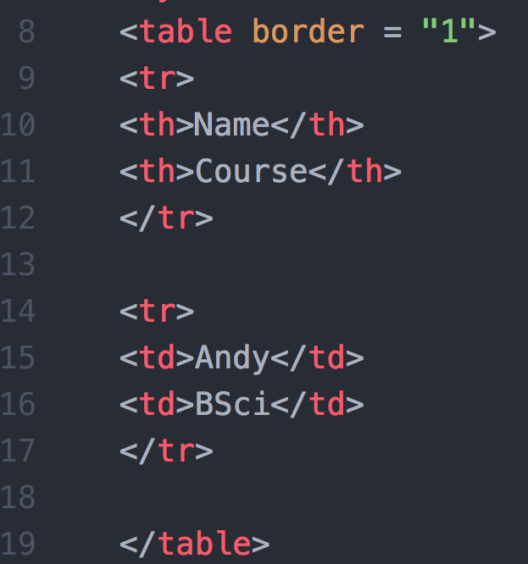
Table tag
Starting Row tag
First Column Header
Second Column Header
Ending Row tag
Table tag

Slide 44
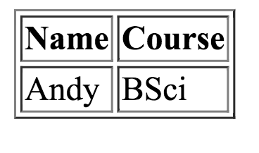

Slide 45

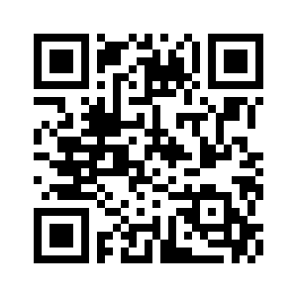
Break: A Word from Our Sponsors
Accenture will be hosting a Hackathon on 30th November. The theme for this year’s Hackathon will be Banking revolution!
Date: 30th November - 1st December, 2019
Location: Level 5, 161 Collins Street,
Melbourne 3000
https://accenture-hackathon-banking.devpost.com/

Slide 46
Exam Preparation
With Kaif Ahsan

Slide 47
Different part of the question:
Algorithmic thinking
Code Generation
Conceptual Questions

Slide 48
Things they expect you to do:
Output Tracing: One-liners, Loops & Functions
Identify and differentiate between different types of errors
Logical Progression:
Being able to reconstruct a program and “Fill in the blanks”
Being able to for a complete program step by step “without a crutch”
Know some of the definitions the course has covered
What is unit testing, debugging etc

Slide 49
Tips for preparation
Re-read GROK worksheets
Do past exam papers
Practice problems on Project Euler
>> Hackerrank is a nice place (www.hackerrank.com)

Slide 50
Practice Coding By Hand!!!
Run the program afterwards to spot your syntax mistakes
If you find the transition hard - start by -
Writing Code in Word or Notepad first
Then move onto the hand-written

Slide 52
FAQs
Will my marks be deducted for same syntax errors?
No
How to do I check my code in the exam?
Think of small test cases (if possible edge cases)

Slide 53
Any Questions?
GOOD LUCK FELLOW COMPadre!!!

